Slide 1



Creating a Galaxy Cluster Simulation to Constrain Cosmology
Keenan Fiedler
Dr. Eduardo Rozo, Dr. Andres Salcedo
University of Arizona

Slide 2
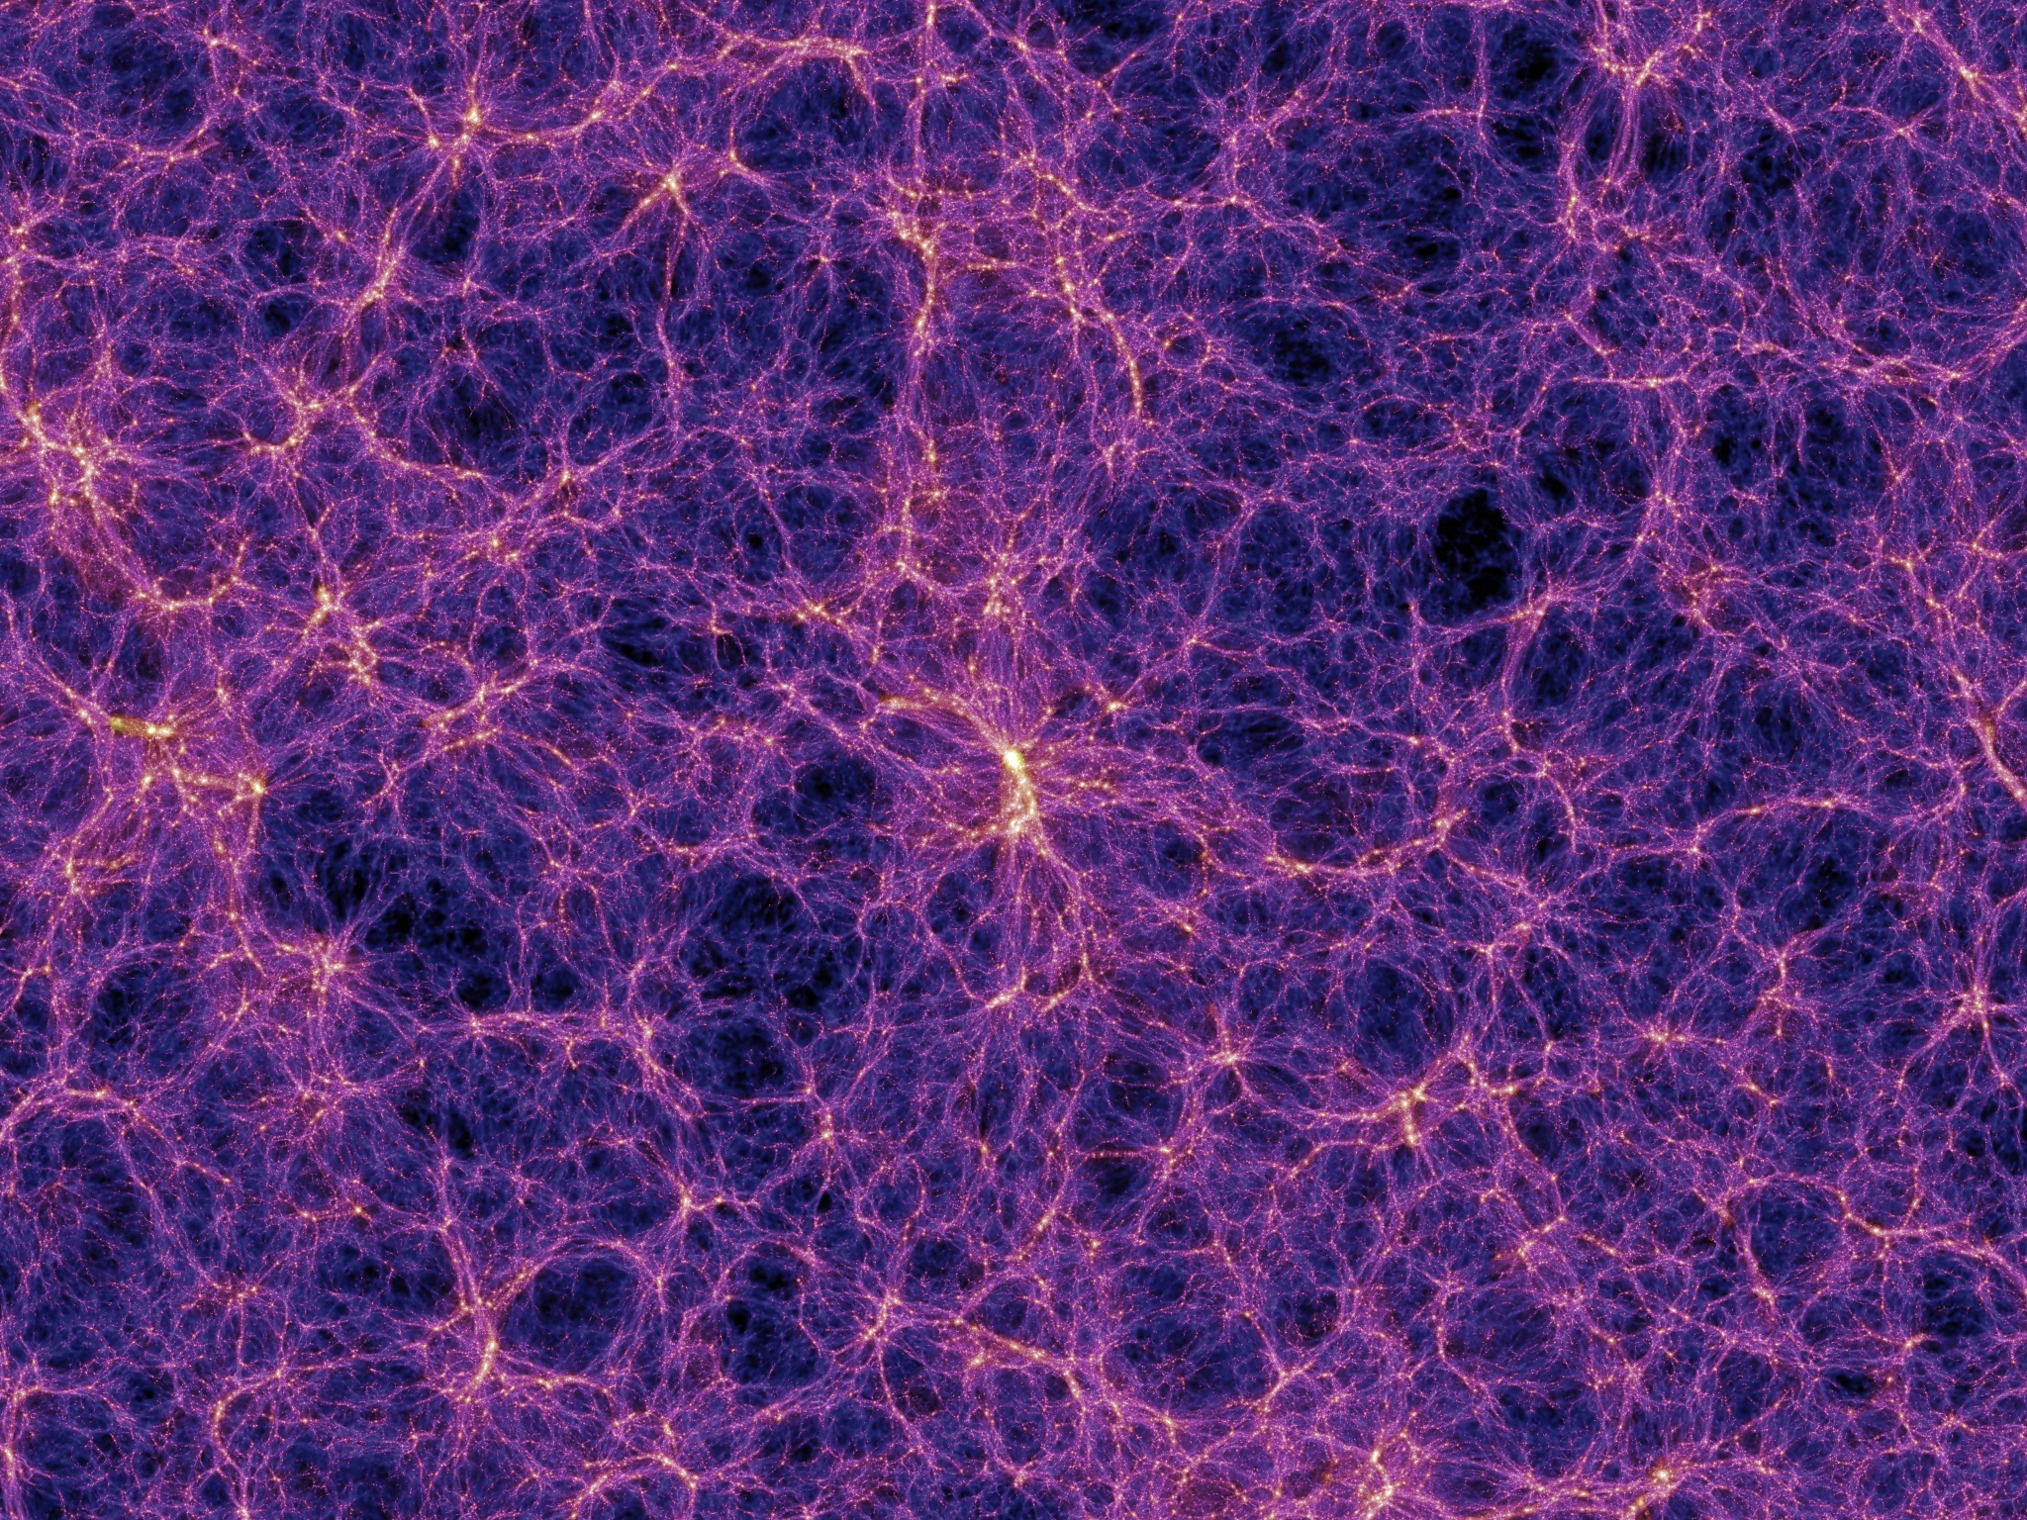
Cosmic Structure
Vast majority of matter is dark
matter, invisible to telescopes
Visible matter cannot form
galaxies without help
Galaxies connect to underlying
dark matter, forming at clumps in
the dark matter called “halos”
How can we connect galaxies to
dark matter?
Image Credit: Springel et al. (2005)
2

Slide 3
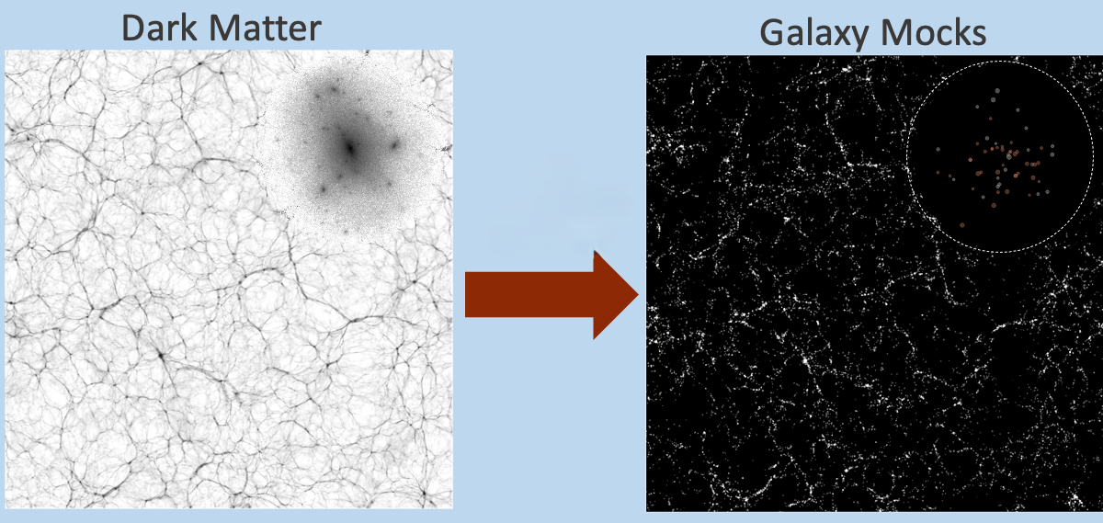
Simulation Based Inference
Use simulations to create
a fake universe
Control all aspects of fake
universe to imitate real data
Infer information by
comparing using a
galaxy cluster finder
Image Credit: To et al. (2023)
3

Slide 4
Transforming Dark Matter into Galaxies
Given a dark matter halo
  Choose number of galaxies
  Give each galaxy the data a
  galaxy survey would have
Know all properties and
parameters of simulation
Image Credit: To et al. (2023)
4

Slide 5
Goals for My Simulation
Highly accurate to real-world data
Able to quickly generate many simulations
  Allows wide parameter range for inference
Build for specific galaxy cluster finder – redMaPPer
  Improve function and accuracy of cluster finder
Build to work with Dr. Salcedo’s pipeline of
simulation-based inference
5

Slide 6
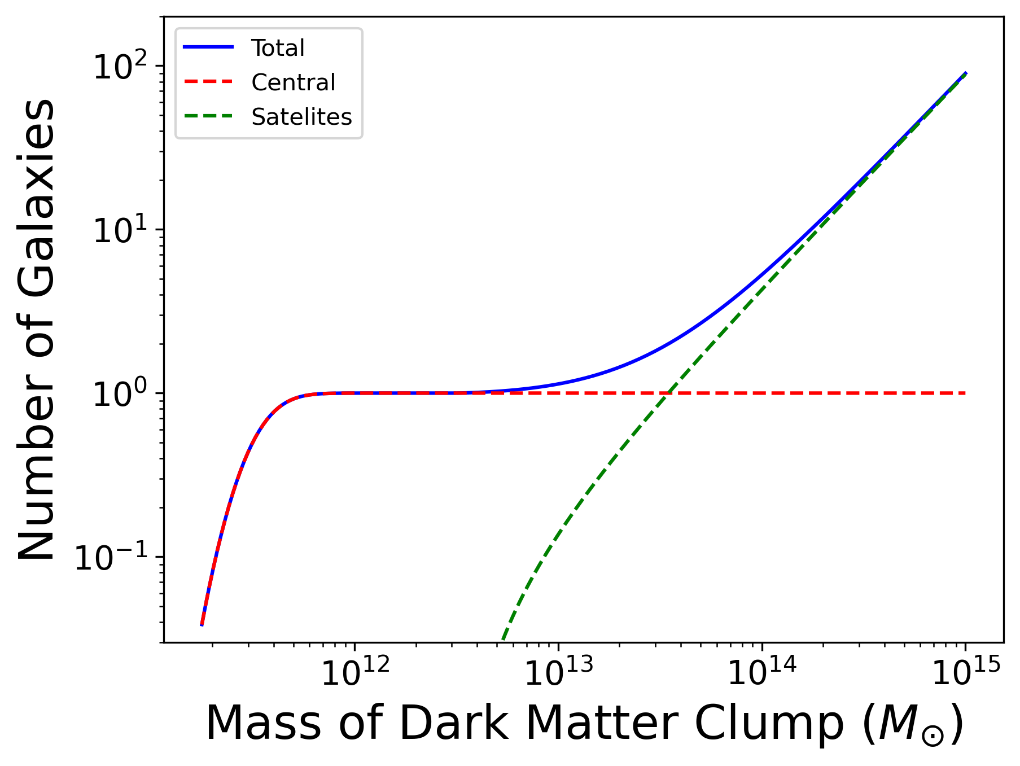
Determining Number of Galaxies
Entirely based on mass of the
dark matter clump
Centrals, the brightest and
most massive galaxies
Satellite galaxies orbiting
the central
6

Slide 7
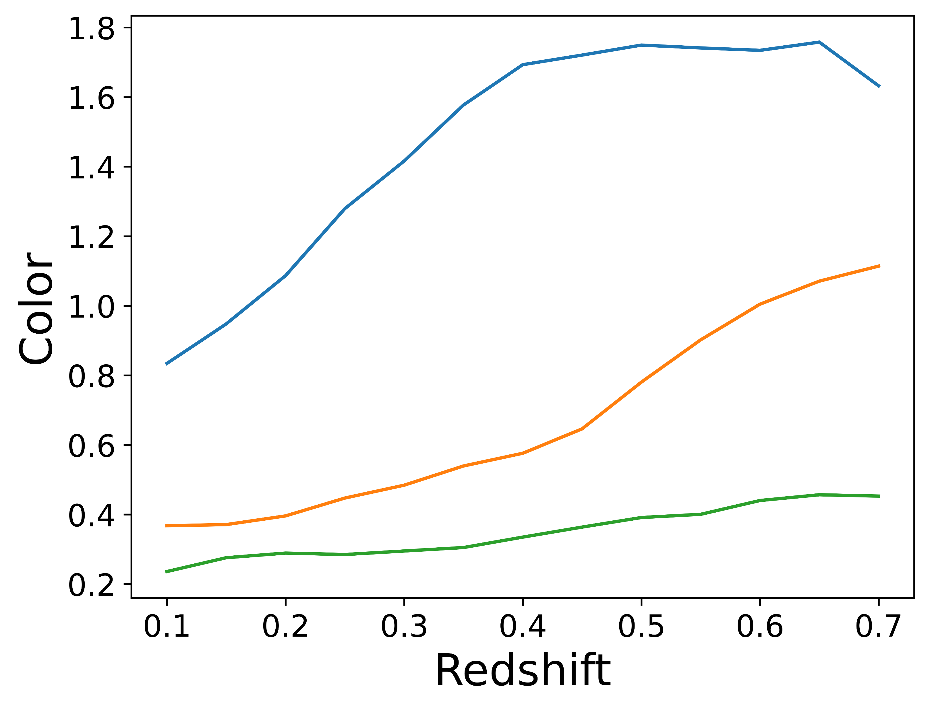
Determining Color of Galaxies
Color is difference in the
brightness of different bands
Important property for
cluster finding with redMaPPer
7

Slide 8
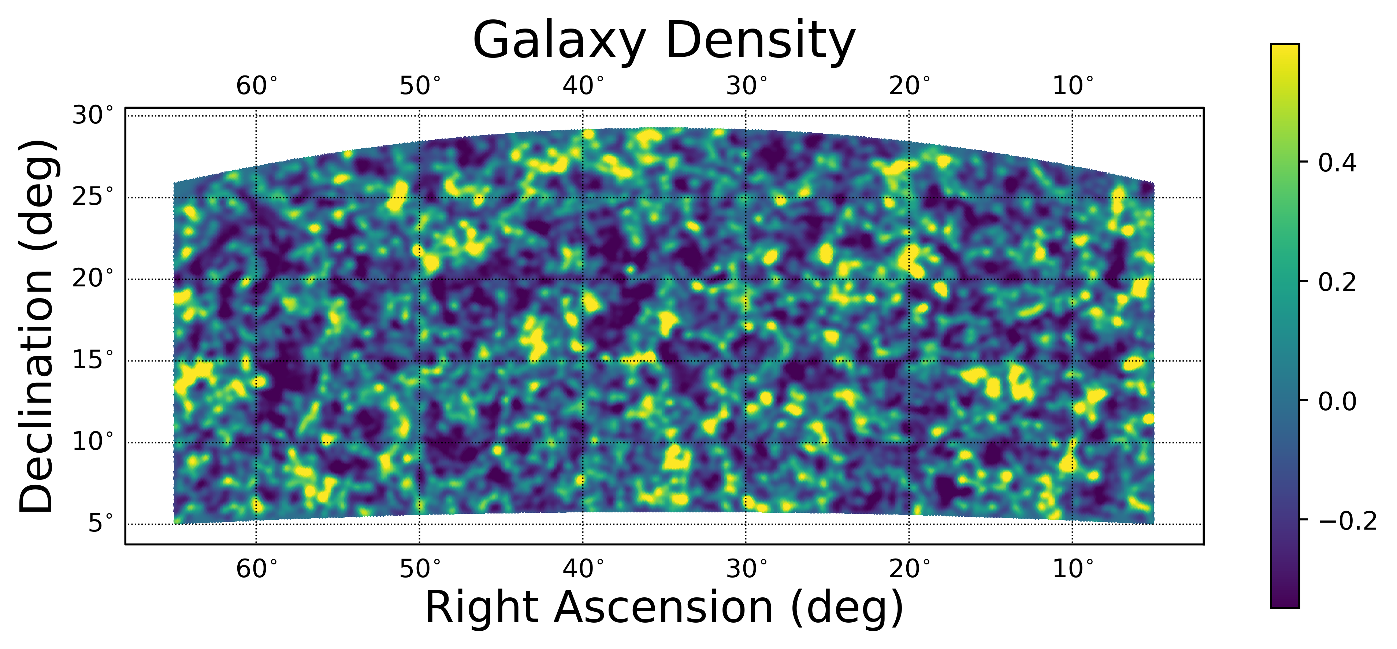
My Galaxy Simulation
Fast - creates a catalog of galaxies takes minutes, not hours
Accurate - includes photometric error and central brightening
8

Slide 9
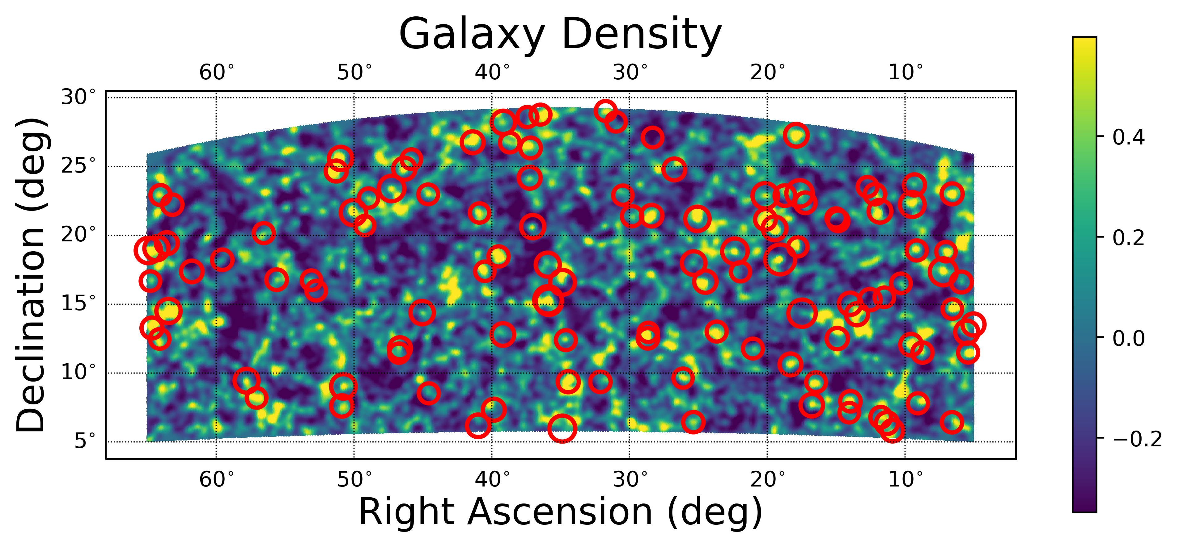
My Galaxy Simulation
Fast - creates a catalog of galaxies takes minutes, not hours
Accurate - includes photometric error and central brightening
8

Slide 10
Next Steps
Confirm accuracy to real world data
Use Dr. Salcedo’s method to measure cosmology
9

Slide 11
Thank You
Acknowledgements
  Dr. Eduardo Rozo
  Dr. Andres Salcedo
  Arizona Space Grant Consortium
  University of Arizona Department of Physics
For questions:
  kfielder@arizona.edu

